Slide 1
Family

Slide 2
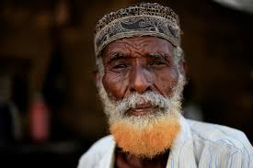
He is a…

Slide 3
He is a grandfather (grandpa)

Slide 4
Spell

Slide 5
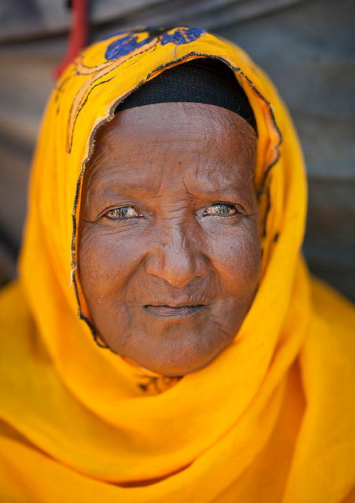
She is a…

Slide 6
She is a grandmother (grandma)

Slide 7
Spell

Slide 8
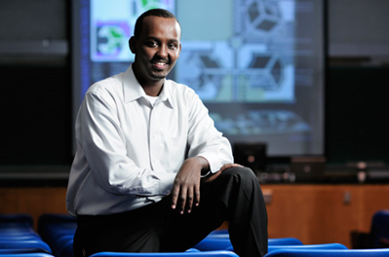
He is a…

Slide 9
He is a father (dad)

Slide 10
Spell

Slide 11
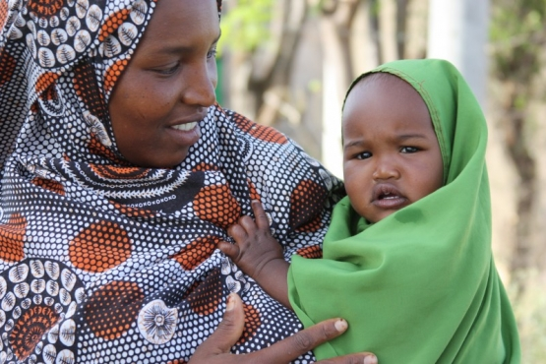
She is a…

Slide 12
She is a mother (mom)

Slide 13
Spell

Slide 14
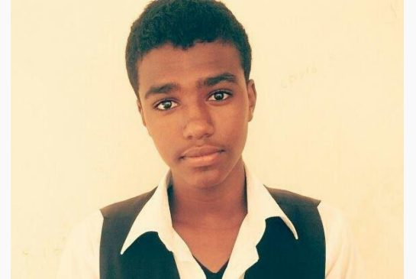
He is a…

Slide 15
He is a son

Slide 16
Spell

Slide 17
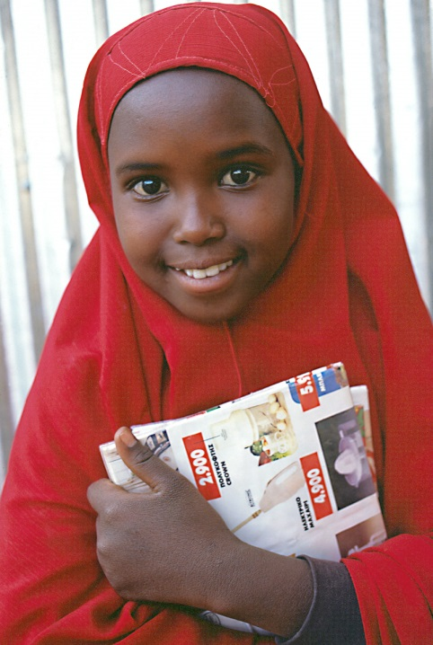
She is a…

Slide 18
She is a daughter

Slide 19
Spell

Slide 21
wife husband

Slide 24
wife husband

Slide 27
sister brother

Slide 29
mother father
daughter son

Slide 30
mother father

Slide 31
daughter son

Slide 32
grand- grand- mother father
grand- grand-
daughter son

Slide 33
grand- grand-
daughter son

Slide 34
grand- grand- mother father

Slide 35
mother father
son

Slide 36
son

Slide 37
mother father

