Slide 1
Elementary School PPT
Co-Planning & Co-Teaching with TAs & Specialists
标题
Number 编号
Author 作者: LEAP Team
Date 日期: August15, 2017

Slide 2
OVERVIEW 概述
Objective:
Teachers will be able to demonstrate their understanding of co-teaching best practices by engaging in initial norming of their co-teaching relationships.

Slide 3
OVERVIEW 概述
Review roles of specialists
Define Co-Teaching and overview models
Co-Planning approaches- getting started
Sit with your specialists if possible!
https://www.youtube.com/watch?v=6llQCG8QhBE 4 min

Slide 4
Co-Teaching 概述
Co-Teaching
Two or more professionals jointly delivering substantive instruction to a diverse, blended group of students in a single physical space.
(Friend & Pope, 2005;Spencer, 2005)

Slide 5
Understanding Roles
Specialists – LEAP – Teaching Assistants
It’s beneficial to understand the goals and responsibilities of your peers
Check mark = I knew that, I agree
Delta = Surprised by or want to bear in mind
? = Curious, want to know more, or disagree with

Slide 6
Moving forward with Co-teaching
Getting to Know Your Partner
Establish rapport
Identify your teaching styles
Discuss strengths and weaknesses

Slide 7
Moving forward with Co-teaching
General Education
Shared
Strategic Teacher
Notes:
Option Activity 1
Trainer Note: Copy this as a handout.
Directions: With your co-teaching partner, compare notes on what knowledge, skills, and characteristics you bring to your co-teaching partnership. Complete the top section of the Venn Diagram together.
Within the bottom half of the Venn Diagram, together respond to the following questions (go to next slide to show questions):
Convey:
Independently complete your section of the Venn Diagram by responding to the questions (previous slide).
With your co-teaching partner(or complete hypothetically with a participant near you), compare notes on what knowledge, skills, and characteristics you bring to a co-teaching partnership. Complete the Venn Diagram and then respond to questions that follow.

Slide 8
Moving forward with Co-teaching
Preparing to Co-Teach: Co-teaching Partners:
Compare strengths each bring to the partnership
How will the similarities shared contribute to the effectiveness of the co-teaching partnership?
How might their differences contribute to the effectiveness of the co-teaching partnership?

Slide 9
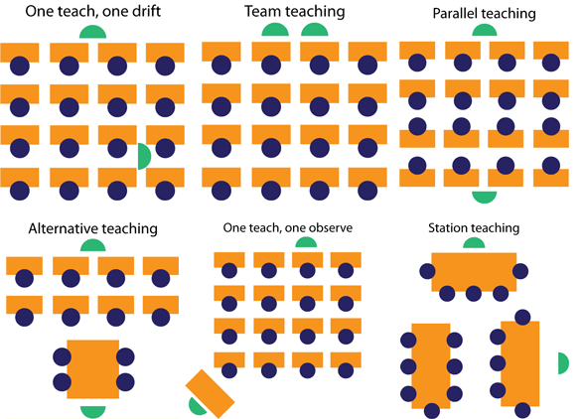
Models

Slide 10
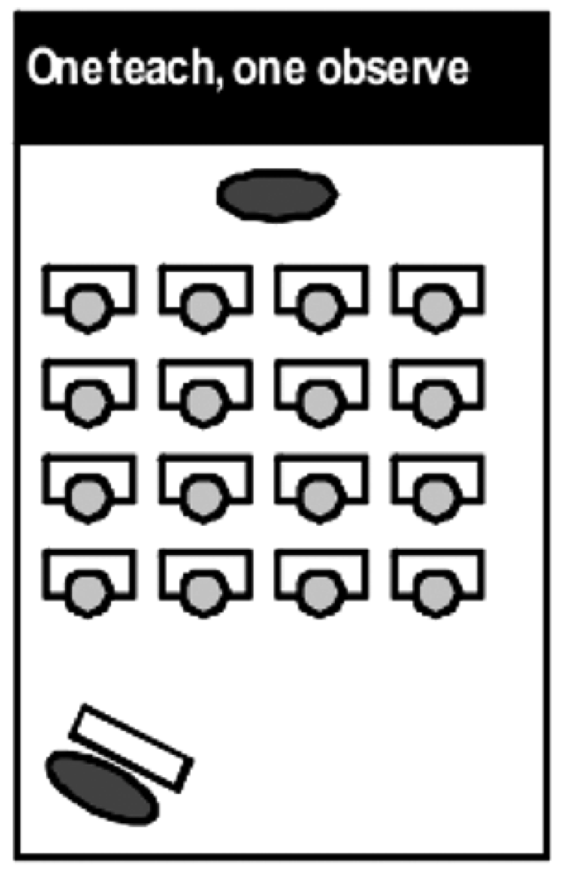
Co-Teaching 概述
One Teach, One Observe (Lead and Support)
One co-teaching partner leads the instruction, while the other partner collects data through observation
Monitoring progress is based on preset criteria
Co-teaching partners pre-determine specific observational information to gather during instruction and together analyze the data for instructional decisions
Roles are to be exchanged to sustain teacher parity

Slide 11
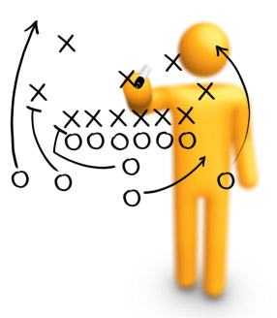
Co-Teaching 概述
Strategies for Implementing One Teach, One Observe
Communicate in/out boxes that do not interrupt teaching
Behavior documentation charts
Materials station- both teachers need access
“See Me Later” Cards

Slide 12
Co-Teaching 概述
One Teach, One Assist Approach (Shadow Teaching)
One co-teacher is primarily responsible for delivery of core instruction while the other co-teacher circulates through the classroom providing support to students as needed.
This approach is the most commonly used, but the least preferred

Slide 13
Co-Teaching 概述
Strategies for Implementing One Teach, One Observe
Have additional supports available for student use.
( e.g. dictionaries or calculators for some students,vocabulary cards for others)
Model appropriate behavior for class
(e.g. active listening)
Notes:
Proximity control is a behavior management system that is useful for helping individual students become aware of their behaviors. It is a non-verbal form of behavior correction that involves simply walking near or over to the student when he or she is demonstrating the problem behavior.

Slide 14
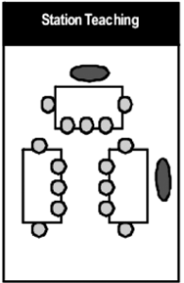
Co-Teaching 概述
Station Teaching Approach
Co-teaching partners divide instructional content into two or more segments, with each partner taking responsibility for delivery of instruction within a station
Students will access both co-teaching partners by rotating from one station to the next, with one station being for independent work
Co-teaching partners should not use this approach when content is required to be taught in sequential order

Slide 15
Co-Teaching 概述
Strategies for Implementing Station Teaching
Use of timers and signals
Practice routines as a class procedure
Have colored index cards stating student role at stations
Table tents with directions
Always have something for them to turn in
Provide Anchor Activities

Slide 16
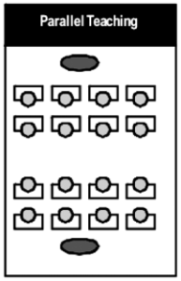
Co-Teaching 概述
Parallel Teaching Approach
Co-teaching partners, each take on an active role
Instructionally by dividing the class Into two groups and teaching the same content simultaneously
This approach allows more supervision of student learning
This approach also provides students a greater chance to participate and interact with their peers

Slide 17
Co-Teaching 概述
Strategies for Implementing Parallel Teaching
Break groups by learning styles
Ensure heterogeneous grouping
Put a deck of cards over desk (on the ceiling) and call suits or matching cards for grouping
Include brain breaks
Teach with a timer to keep everyone
on track

Slide 18
Co-Teaching 概述
Alternative Teaching Approach
One co-teaching partner takes responsibility for instructing the large group while the other works with a small group for a specific instructional purpose
The temporarily formed group maybe based on enrichment, re-teaching, interest area, pre-teaching, etc.
Roles are exchanged to sustain teacher parity

Slide 19
Co-Teaching 概述
Strategies for Implementing Alternative Teaching
Use mini dry erase boards
Have accessible computer station or iPads
Create individualized folders with appropriate work
Provide leveled/guided reading

Slide 20
Co-Teaching 概述
Teaming Approach Speak & Add, Speak & Chart
Both Co-teaching partners are fully engaged in leading the delivery of core instruction at the same time
Co-Teaching partners are delivering the same instruction simultaneously
Co-teachers may have equally active roles, such as
Speak & Chart -one co-teacher leading the large-group lesson while the other models note-taking
Speak & Add - restates key concepts for clarification

Slide 21
Co-Teaching 概述
Speak and Add
Co-Teaching partners are on stage at the same time.
One partner leads the instruction while the other
adds to the lesson by…
~ asking students questions,
~ stating important information,
~ asking co-teaching partner for clarification (referencing),
~ uses humor,
~ adds another perspective, and
~ adding new information by way of anecdotes, real world examples, short stories, etc.

Slide 22
Co-Teaching 概述
Strategies for Implementing Speak and Add
Develop a signal before interjecting information
General educator asks for input
Questions are asked for clarification
Engage in referencing

Slide 23
Co-Teaching 概述
Speak and Chart
One co-teaching partner presents the information, while the other charts key points and student responses.
Variety of graphic organizers are used to model connections of information
Copies of organizers and note taking are modeled

Slide 24
Co-Teaching 概述
Strategies for Implementing Speak and Add
Have a variety of graphic organizers to model connections of information
Copies of organizers and note taking assists all learners
Use copies for students who have been absent
Use charting for review

Slide 25
Moving forward with Co-teaching
“Collaboration allows us to de-privatize our practice” Jon Nordmeyer WIDA International
Co-assessing
Co-reflecting
Co-planning

Slide 26
Moving forward with Co-teaching
Getting started Co-Teaching
Share co-teaching strategies
Develop norms, expectations, teaching agreements
Small steps first: target a project or assignment

Slide 27
Moving forward with Co-teaching
Menu Approach – (With your TAs and LEAP specialist)
Choose 1-2 of the Co-teaching models that you have not tried before
Determine realistic context that you will be working together in such as:
Introducing Journeys vocabulary
Teaching grammar
Doing guided reading groups
Teaching reading strategy
Order off “the menu”
Pick 2-4 specific things you’d like to try from the collaboration menu
Discuss how you might divvy up responsibilities and deliver instruction as a unit
Write down who will do what
Add “cocktails” - talk about ways to extend or add to this

Slide 28
Moving forward with Co-teaching
Use Daystar’s Norms of Collaboration!
Moving Forward
Try a Collaboration Log
✓ What is our student learning focus?
✓ What student work/assessment data can we look at to help us understand this?
✓ What are some instructional moves we can make to help students achieve these learning targets?
✓ What is a realistic time frame for our work?
Discuss Norms
Make a norm list with your TA and LEAP specialist
I will
I will not
Feel free to

Slide 29
Thank You! 谢谢！

