Slide 1
Co-Teaching 概述
Co-Teaching
Two or more professionals jointly delivering substantive instruction to a diverse, blended group of students in a single physical space.
(Friend & Pope, 2005;Spencer, 2005)

Slide 2
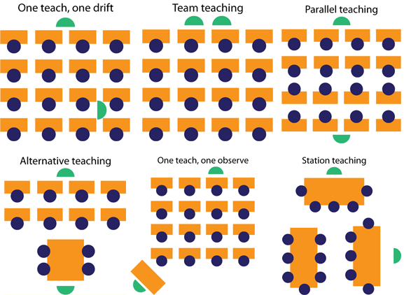
Models

Slide 3
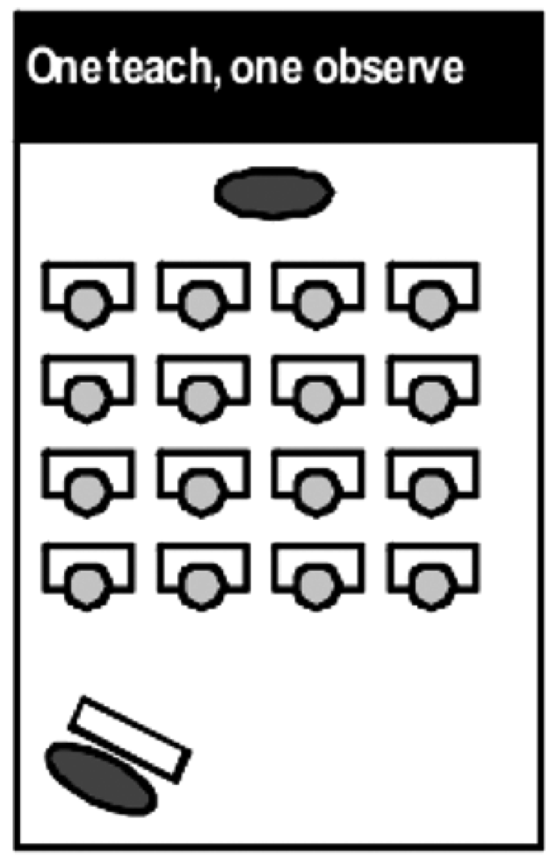
Co-Teaching 概述
One Teach, One Observe (Lead and Support)
One co-teaching partner leads the instruction, while the other partner collects data through observation
Monitoring progress is based on preset criteria
Co-teaching partners pre-determine specific observational information to gather during instruction and together analyze the data for instructional decisions
Roles are to be exchanged to sustain teacher parity

Slide 4
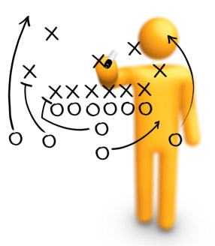
Co-Teaching 概述
Strategies for Implementing One Teach, One Observe
Communicate in/out boxes that do not interrupt teaching
Behavior documentation charts
Materials station- both teachers need access
“See Me Later” Cards

Slide 5
Co-Teaching 概述
One Teach, One Assist Approach (Shadow Teaching)
One co-teacher is primarily responsible for delivery of core instruction while the other co-teacher circulates through the classroom providing support to students as needed.
This approach is the most commonly used, but the least preferred

Slide 6
Co-Teaching 概述
Strategies for Implementing One Teach, One Observe
Have additional supports available for student use.
( e.g. dictionaries or calculators for some students,vocabulary cards for others)
Model appropriate behavior for class
(e.g. active listening)
Notes:
Proximity control is a behavior management system that is useful for helping individual students become aware of their behaviors. It is a non-verbal form of behavior correction that involves simply walking near or over to the student when he or she is demonstrating the problem behavior.

Slide 7
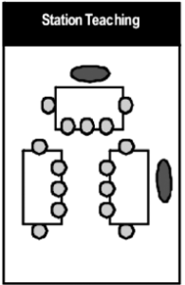
Co-Teaching 概述
Station Teaching Approach
Co-teaching partners divide instructional content into two or more segments, with each partner taking responsibility for delivery of instruction within a station
Students will access both co-teaching partners by rotating from one station to the next, with one station being for independent work
Co-teaching partners should not use this approach when content is required to be taught in sequential order

Slide 8
Co-Teaching 概述
Strategies for Implementing Station Teaching
Use of timers and signals
Practice routines as a class procedure
Have colored index cards stating student role at stations
Table tents with directions
Always have something for them to turn in
Provide Anchor Activities

Slide 9
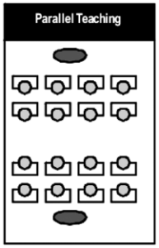
Co-Teaching 概述
Parallel Teaching Approach
Co-teaching partners, each take on an active role
Instructionally by dividing the class Into two groups and teaching the same content simultaneously
This approach allows more supervision of student learning
This approach also provides students a greater chance to participate and interact with their peers

Slide 10
Co-Teaching 概述
Strategies for Implementing Parallel Teaching
Break groups by learning styles
Ensure heterogeneous grouping
Put a deck of cards over desk (on the ceiling) and call suits or matching cards for grouping
Include brain breaks
Teach with a timer to keep everyone
on track

Slide 11
Co-Teaching 概述
Alternative Teaching Approach
One co-teaching partner takes responsibility for instructing the large group while the other works with a small group for a specific instructional purpose
The temporarily formed group maybe based on enrichment, re-teaching, interest area, pre-teaching, etc.
Roles are exchanged to sustain teacher parity

Slide 12
Co-Teaching 概述
Strategies for Implementing Alternative Teaching
Use mini dry erase boards
Have accessible computer station or iPads
Create individualized folders with appropriate work
Provide leveled/guided reading

Slide 13
Co-Teaching 概述
Teaming Approach Speak & Add, Speak & Chart
Both Co-teaching partners are fully engaged in leading the delivery of core instruction at the same time
Co-Teaching partners are delivering the same instruction simultaneously
Co-teachers may have equally active roles, such as
Speak & Chart -one co-teacher leading the large-group lesson while the other models note-taking
Speak & Add - restates key concepts for clarification

Slide 14
Co-Teaching 概述
Speak and Add
Co-Teaching partners are on stage at the same time.
One partner leads the instruction while the other
adds to the lesson by…
~ asking students questions,
~ stating important information,
~ asking co-teaching partner for clarification (referencing),
~ uses humor,
~ adds another perspective, and
~ adding new information by way of anecdotes, real world examples, short stories, etc.

Slide 15
Co-Teaching 概述
Strategies for Implementing Speak and Add
Develop a signal before interjecting information
General educator asks for input
Questions are asked for clarification
Engage in referencing

Slide 16
Co-Teaching 概述
Speak and Chart
One co-teaching partner presents the information, while the other charts key points and student responses.
Variety of graphic organizers are used to model connections of information
Copies of organizers and note taking are modeled

Slide 17
Co-Teaching 概述
Strategies for Implementing Speak and Add
Have a variety of graphic organizers to model connections of information
Copies of organizers and note taking assists all learners
Use copies for students who have been absent
Use charting for review

